Slide 1
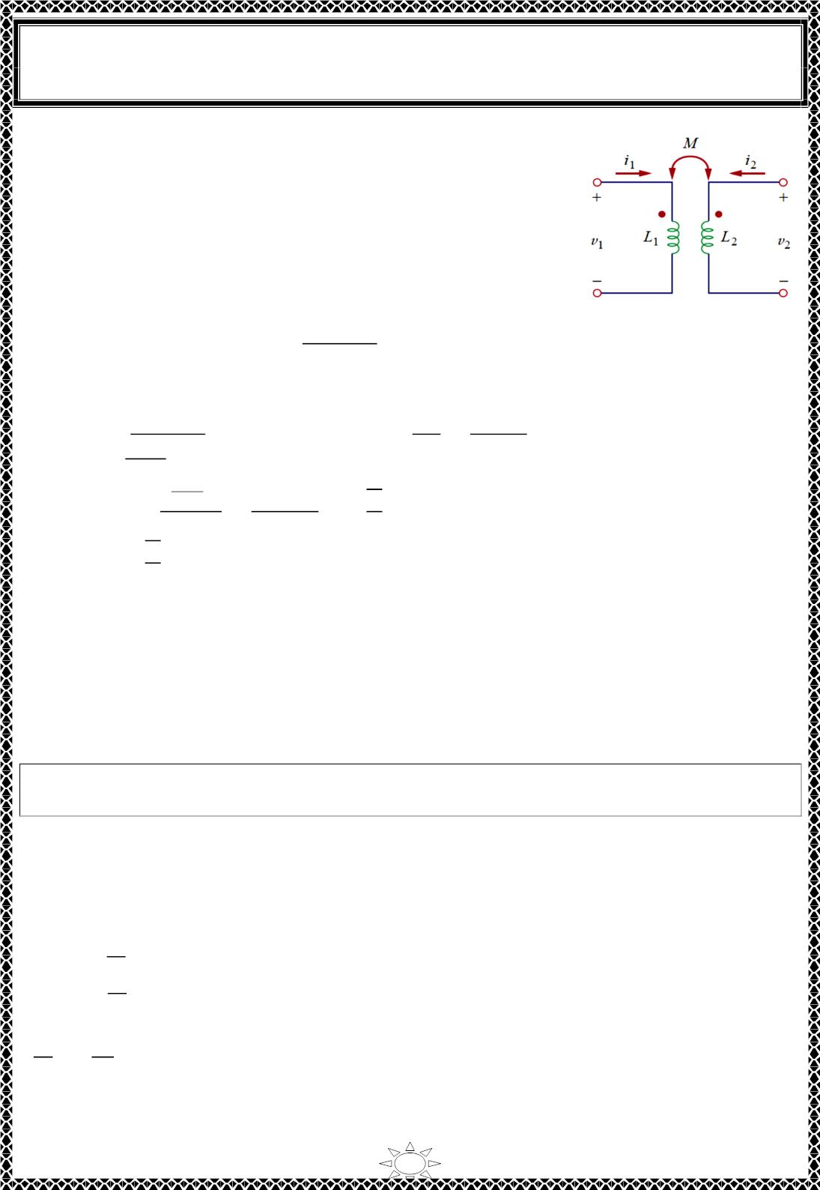
University of Diyala
Engineering College
Electronic Department
Electrical Circuits
2nd Class
Lecturer : Wisam N. AL-Obaidi
Year (2015-2016)
10) Ideal Transformers
An ideal transformer is one with perfect coupling (k =1 ). It
consists of two (or more) coils with a large number of turns
wound on a common core of high permeability. Because of this
high permeability of the core, the flux links all the turns of both
coils, thereby resulting in a perfect coupling. Consider the circuit
in Fig.10.1.
In the frequency domain,
ꢀꢁ^{− ꢂꢃꢄꢅ}
Fig.10.1
푉 = 푗휔퐿 퐼 + 푗휔푀퐼 → 퐼 =
ꢆ
…(10.1)
…(10.2)
1
1 1
2
1
ꢂꢃꢇꢁ
푉 = 푗휔푀퐼 + 푗휔퐿 퐼
2 2
2
1
Substituting Eq. (10.1 ) in (10.2) gives
^{ꢂꢃꢄꢆꢅ}ꢆ
ꢀꢁ^{− ꢂꢃꢄꢅ}
ꢄꢀ
푉₂ = 푗휔푀 (
ꢆ
ꢁ
) + 푗휔퐿 퐼 = 푗휔퐿 퐼 +
ꢈ
…(10.3)
…(10.4)
ꢂꢃꢇꢁ
2 2
2 2
ꢇꢁ
ꢇꢁ
But 푀 = √퐿 퐿 for perfect coupling (k =1 ). Hence,
1
2
√ꢇ ꢇ ꢀ
ꢂꢃꢇ ꢇ ꢅ
ꢆ ꢆ = ꢉ^{ꢇ}
푉 = 푗휔퐿 퐼 +
ꢁ
ꢆ
ꢁ
ꢈ
ꢁ
ꢇꢁ
ꢆ
푉₁ = 푛푉
1
2
2 2
ꢇꢁ
ꢇ
ꢁ
Trail Version
Trail Version
Trail Version
Trail Version
Trail Version
Trail Version
Trail Version
Trail Version
Trail Version
Trail Version
Trail Version
Trail Version
Trail Version
^{ꢇ}ꢆ
ꢇꢁ
where 푛 = ꢉ and is called the turns ratio.
As 퐿 , 퐿 , 푀 → ∞ such that n remains the same, the coupled coils become an ideal
1
2
transformer.
A transformer is said to be ideal if it has the following properties:
1. Coils have very large reactances (퐿 , 퐿 , 푀 → ∞ ).
1
2
2. Coupling coefficient is equal to unity (k =1 ).
3. Primary and secondary coils are lossless (푅 = 0, 푅 = 0)
1
2
An ideal transformer is a unity-coupled, lossless transformer in which the primary
and secondary coils have infinite self-inductances.
Iron-core transformers are close approximations to ideal transformers. These are used in
power systems and electronics.
When a sinusoidal voltage is applied to the primary winding of ideal transformer as shown
in Fig.10.2. and according to Faraday’s law, the voltage across its windings are,
푣₁ = 푁
푑∅
…(10.5)
…(10.6)
1
푑푡
푑∅
푣₂ = 푁₂
푑푡
Divide Eq.(10.6) by (10.5), we get
ꢊ
ꢋ
^{ꢆ} = ^{ꢆ} =
ꢋ
ꢊ
ꢁ
ꢁ
푛
…(10.7)
where n is, again, the turns ratio or transformation ratio. We can use the phasor voltages and
rather than the instantaneous values and Thus, Eq. (10.7) may be written as
16

Slide 2
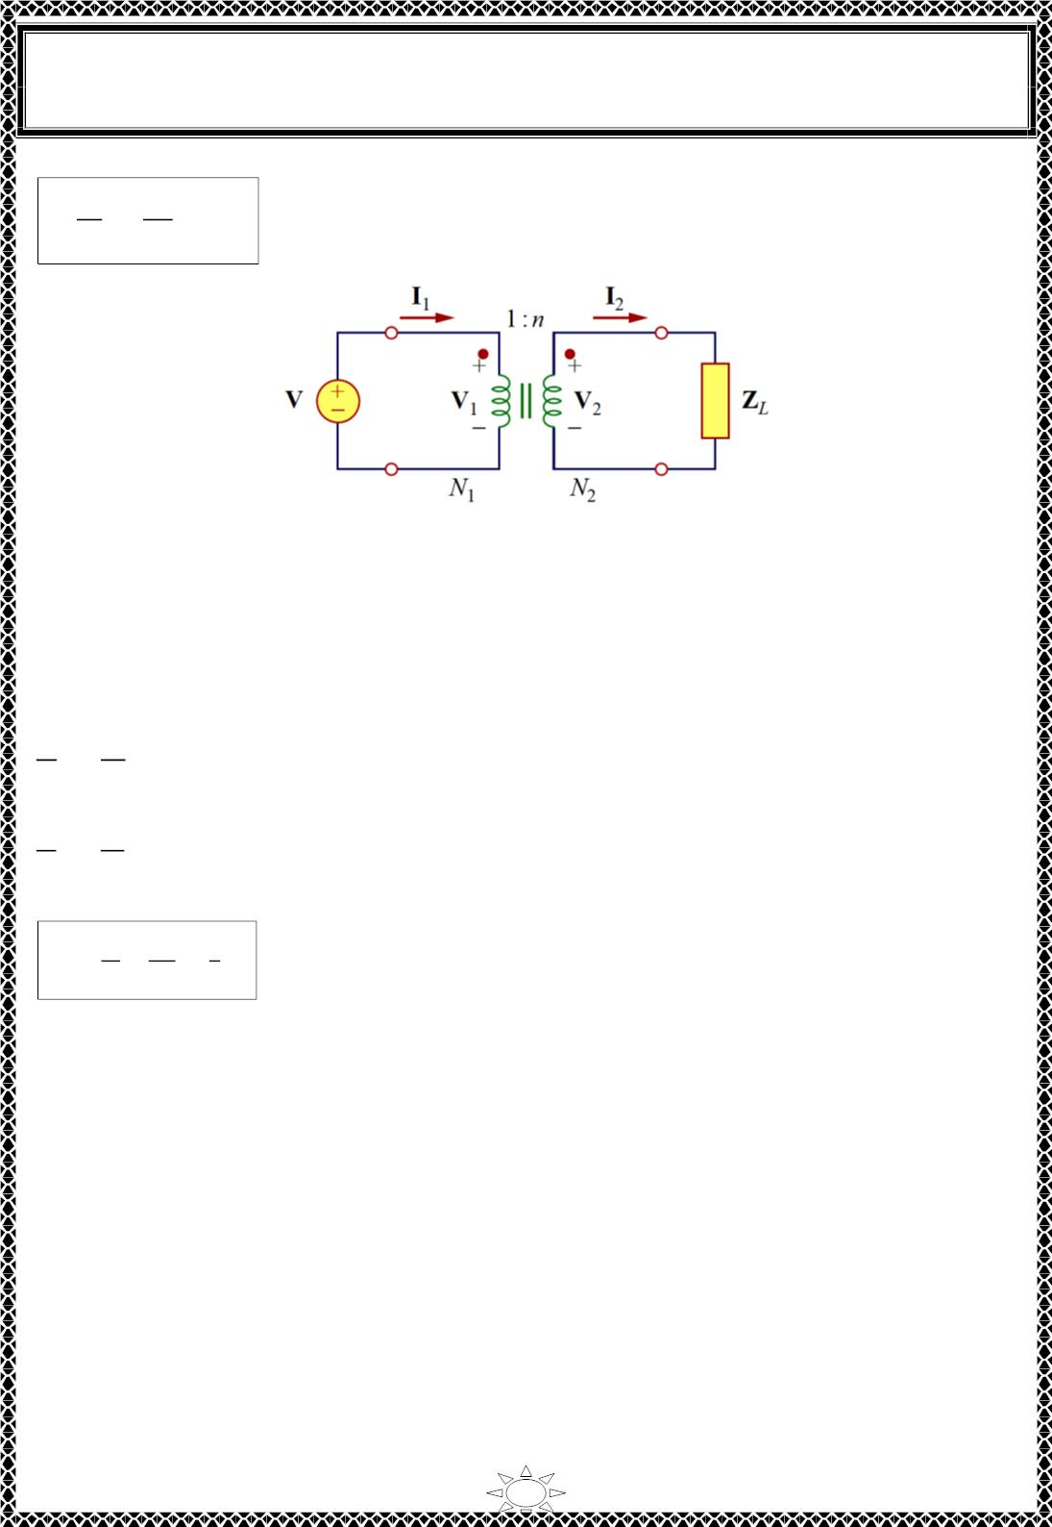
University of Diyala
Engineering College
Electronic Department
Electrical Circuits
2nd Class
Lecturer : Wisam N. AL-Obaidi
Year (2015-2016)
ꢄ
푁₂
푁
1
…(10.8)
2
ꢄ
1
=
= 푛
Fig.10.2
For the reason of power conservation, the energy supplied to the primary must equal the
energy absorbed by the secondary, since there are no losses in an ideal transformer. This
implies that
푣 푖 = 푣 푖
or
…(10.9)
1 1
2 2
Trail Version
Trail Version
Trail Version
Trail Version
Trail Version
Trail Version
Trail Version
Trail Version
Trail Version
Trail Version
Trail Version
Trail Version
Trail Version
ꢀꢁ
=
ꢃ_{ꢂ}
= 푛
…(10.10)
ꢀ
ꢂ
ꢃ
ꢁ
In phasor form,
퐼ꢁ
퐼_{ꢂ}
=
푉
ꢂ
푉
ꢁ
= 푛
…(10.11)
…(10.12)
∴
ꢅ₂
푁
1
ꢆ
푛
=
=
ꢅ₁ 푁₂
1) If n > 1 (i.e. N > N & V > V ), then the transformer is called 'step-up transformer'.
2
1
2
1
2) If n < 1 (i.e. N < N & V < V ), then the transformer is called 'step-down transformer'.
2
1
2
1
3) If n = 1 (i.e. N = N & V = V ),then the transformer is called 'isolation transformer' or
2
1
2
1
1:1 transformer.
It is important that we know how to get the proper polarity of the voltages and the
direction of the currents for the transformer in Fig.10.2. If the polarity of V or V or the
1
2
direction of I or I is changed, n in Eqs. (10.7) to (10.12) may need to be replaced by
1
2
(−푛). The two simple rules to follow are:
1) If V and V are both positive or both negative at the dotted terminals, use (+푛) in
1
2
Eq.(10.8). Otherwise, use (−푛)
2) If I and I both enter into or both leave the dotted terminals, use (−푛) in Eq.(10.12).
1
2
Otherwise, use (+푛)
17

Slide 3
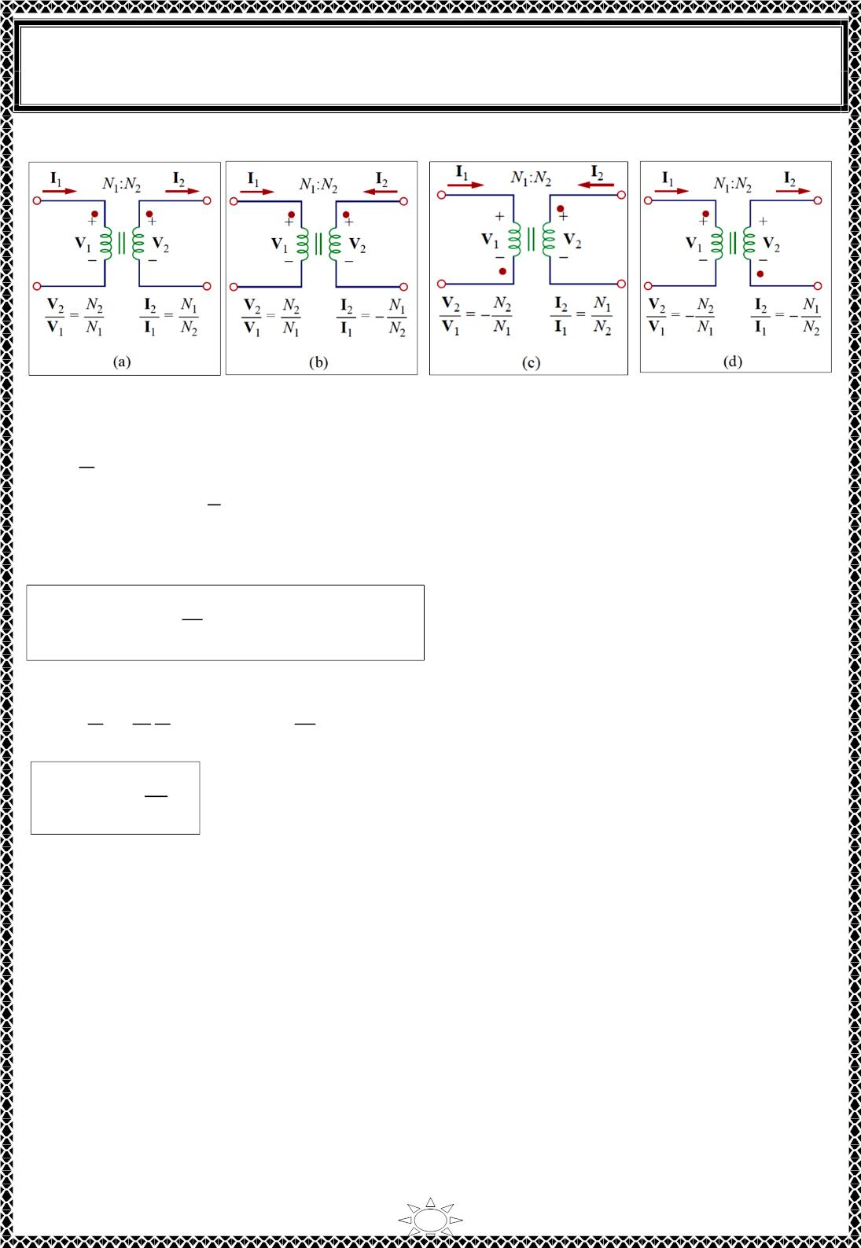
University of Diyala
Engineering College
Electronic Department
Electrical Circuits
2nd Class
Lecturer : Wisam N. AL-Obaidi
Year (2015-2016)
The rules are demonstrated with the four circuits in Fig.10.3.
Fig.10.3
ꢀ
2
푉₁ =
표푟 푉ꢁ = ꢂ푉
…(10.13)
푛
1
^{ꢃ}ꢄ
퐼 = ꢂ퐼 표푟 퐼 =
…(10.14)
1
ꢁ
ꢁ
푛
The complex power in the primary winding is
Trail Version
Trail Version
Trail Version
Trail Version
Trail Version
Trail Version
Trail Version
Trail Version
Trail Version
Trail Version
Trail Version
Trail Version
Trail Version
푉
…(10.15)
ꢁ
푆 = 푉 퐼∗ = (ꢂ퐼 )∗ = 푉 퐼∗ = 푆
1
1 1
ꢂ
ꢁ
ꢁ ꢁ
ꢁ
The input impedance is found as,
ꢀ
1 ꢀ
푉_{ꢅ}
퐼_{ꢅ}
ꢄ
2
푍 =
푖푛
=
& 푍_{퐿} =
^{ꢃ}ꢄ
푛² ꢃ₂
∴ 푍_{푖푛} =
푍_{퐿}
ꢂꢁ
…(10.16)
The input impedance is also called the reflected impedance, since it appears as if the load
impedance is reflected to the primary side. This ability of the transformer to transform a
given impedance into another impedance provides us a means of impedance matching to
ensure maximum power transfer.
In analyzing a circuit containing an ideal transformer, it is common practice to eliminate
the transformer by reflecting impedances and sources from one side of the transformer to
the other. In the circuit of Fig.10.4, suppose we want to reflect the secondary side of the
circuit to the primary side. We find the Thevenin equivalent of the circuit to the right of
the terminals We obtain V_{TH} as the open-circuit voltage at terminals a-b, as shown in
Fig.10.5(a).
18

Slide 4
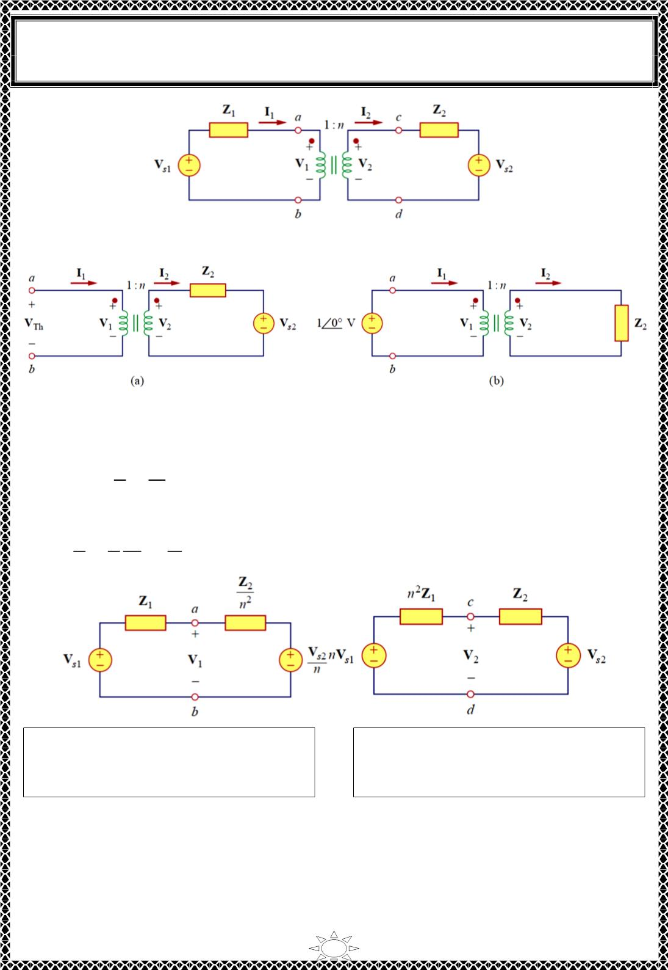
University of Diyala
Engineering College
Electronic Department
Electrical Circuits
2nd Class
Lecturer : Wisam N. AL-Obaidi
Year (2015-2016)
Fig.10.4
Fig.10.5(a) Obtaining V for Fig. 10.4, (b) obtaining Z for Fig. 10.4.
Th
Th
Trail Version
Trail Version
Trail Version
Trail Version
Trail Version
Trail Version
Trail Version
Trail Version
Trail Version
Trail Version
Trail Version
Trail Version
Trail Version
Since terminals a-b are open, I = 0 = I so that V = V Hence, From Eq. (10.13),
ꢀ
ꢀ
1
2
1
2
푉
푇퐻
2
푠2
= 푉₁ =
=
…(10.17)
푛
푛
To get Z_{Th} we remove the voltage source in the secondary winding and insert a unit
source at terminals a-b as in Fig. 10.5(b). From Eqs. (10.13) and (10.13),
ꢀ
ꢀ
1
^{ꢂ}2
푛²
푍_{푇퐻}
ꢁ
2
=
=
=
,
푉 = 푍 ꢄ
…(10.18)
퐼ꢁ
푛 푛퐼₂
ꢃ
ꢃ ꢃ
Fig. 10.6 Equivalent circuit for Fig.10.4
obtained by reflecting the secondary
circuit to the primary side
Fig. 10.7 Equivalent circuit for Fig.10.4
obtained by reflecting the primary
circuit to the secondary side
1)
The general rule for eliminating the transformer and reflecting the secondary
circuit to the primary side is: divide the secondary impedance by n², divide the secondary voltage by n,
and multiply the secondary current by n.
2)
The rule for eliminating the transformer and reflecting the primary circuit to the secondary side
is: multiply the primary impedance by n², multiply the primary voltage by n, and divide the primary
current by n.
19

Slide 5
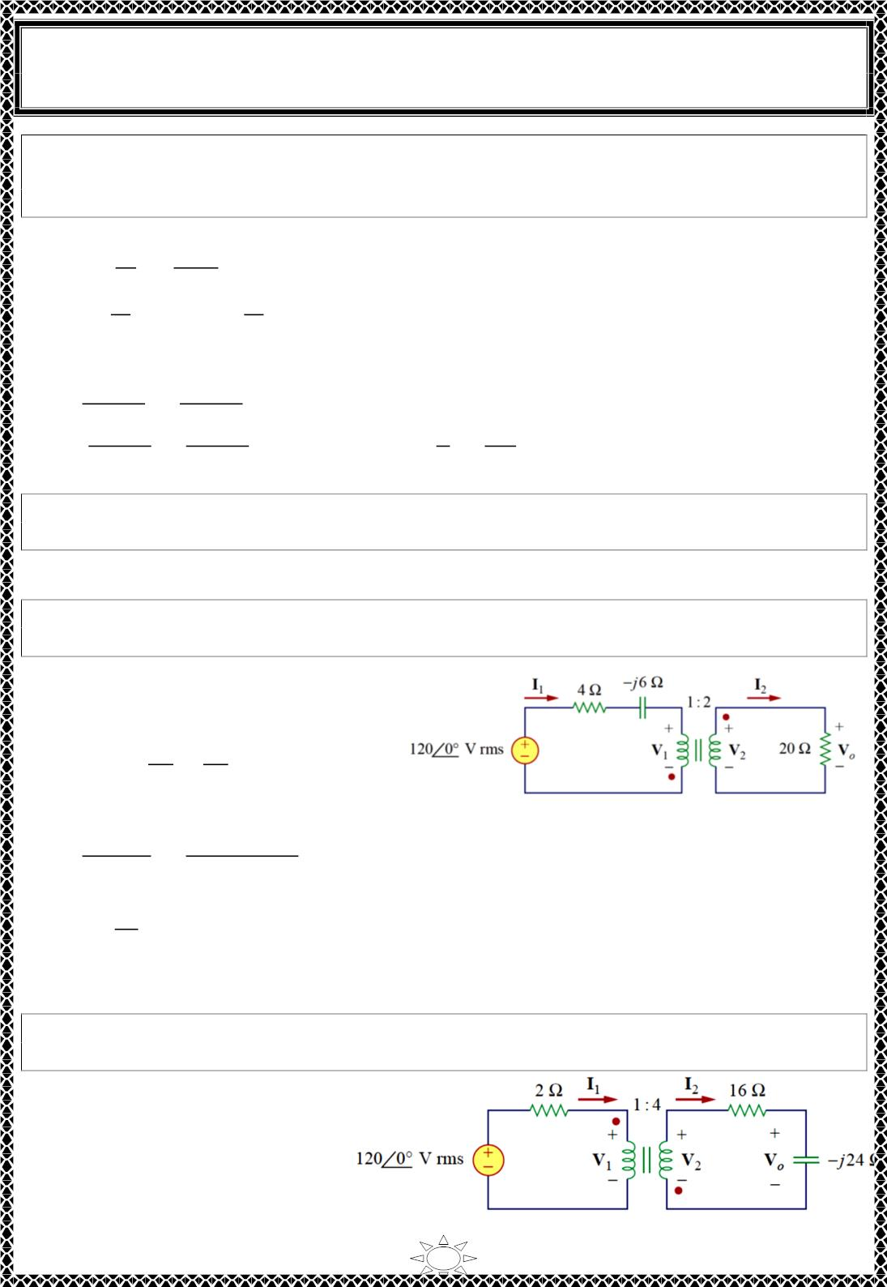
University of Diyala
Engineering College
Electronic Department
Electrical Circuits
2nd Class
Lecturer : Wisam N. AL-Obaidi
Year (2015-2016)
Example 9:An ideal transformer is rated at 2400/120 V, 9.6 kVA, and has 50 turns on the
secondary side. Calculate: (a) the turns ratio, (b) the number of turns on the primary side,
and (c) the current ratings for the primary and secondary windings.
Solution:
^{푣}2
ꢀꢁ0
(a) 푛 =
=
= ꢂ.ꢂ5
푣
ꢁ400
1
^{푁}2
ꢃ0
(b) 푛 =
→ ꢂ.ꢂ5 =
→ ꢄꢀ = ꢅꢂꢂꢂ 푡푢푟푛푠
푁
1
푁
1
(c) 푆 = 푉 퐼 = 푉 퐼 = 9.6 kVA
ꢀ
ꢀ ꢀ
ꢁ ꢁ
퐼ꢀ =
ꢆꢇ00 ꢈꢉ
=
ꢆꢇ00 ꢈꢉ
= ꢋ A
ꢊ
ꢁ400
ꢆꢇ00 ꢈꢉ
1
퐼ꢁ =
ꢆꢇ00 ꢈꢉ
=
^{ꢌ}1
ꢍ
4퐴
ꢊ
2
ꢀꢁ0
= 8ꢂ A or 퐼ꢁ =
=
0.0ꢃ
= 8ꢂ A
H.W.7: The primary current to an ideal transformer rated at 3300/110 is 5 A. Calculate:
(a) the turns ratio, (b) the kVA rating, (c) the secondary current.
Answer: (a) 1/30, (b) 16.5 kVA, (c) 150 A.
Trail Version
Trail Version
Trail Version
Trail Version
Trail Version
Trail Version
Trail Version
Trail Version
Trail Version
Trail Version
Trail Version
Trail Version
Trail Version
Example 10: For the ideal transformer circuit of Fig. shown, find: (a) the source current
퐼 (b) the output voltage 푉 and (c) the complex power supplied by the source.
ꢀ
푂
Solution:
(a)The 20Ω impedance can be reflected
to the primary side and we get
ꢎꢂ ꢎꢂ
푍_{푅} =
=
= 5 Ω
푛ꢁ
ꢎꢁ
∴ 푍 = ꢋ − 푗6 + 푍 = 9 − j6 = ꢅꢂ.8ꢎ∠ − 33.69^{ꢏ}Ω
푖ꢍ
퐼ꢀ =
ꢑ
푅
ꢑ
ꢀꢁ0∠ꢐ0
=
ꢀꢁ0∠ꢐ0
= ꢅꢅ.ꢂ9∠33.69^{ꢏ} ꢗ
ꢒ
ꢓꢔ
ꢀ0.ꢕꢁ∠ꢐꢖꢖ.ꢇꢆ^{ꢑ}
(b) since both I & I leave the dotted terminals,
ꢀ
1
2
퐼ꢁ = (− ) 퐼ꢀ = −5.5ꢋ5∠33.69^{ꢏ} ꢗ
ꢍ
푉 = ꢎꢂ 퐼 = ꢅꢅꢂ.9∠ꢎꢅ3.69^{ꢏ} 푉
표
ꢁ
(c) 푆 = 푉 퐼
∗ = ꢙꢅꢎꢂ∠ꢂ^{ꢏ}ꢚꢙꢅꢅ.ꢂ9∠−33.69^{ꢏ}ꢚ = ꢅ33ꢂ.8∠−33.69^{ꢏ} VA
ꢘ ꢀ
ꢀ
H.W.8: In the ideal transformer circuit of Fig. shown, find 푉_{푂} and the complex power
supplied by the source.
Answer:
ꢎꢅꢋ.7∠ꢅꢅ6.56^{ꢏ} V,
ꢋ.ꢎ93∠−ꢎ6.56^{ꢏ} kVA
20

Slide 6
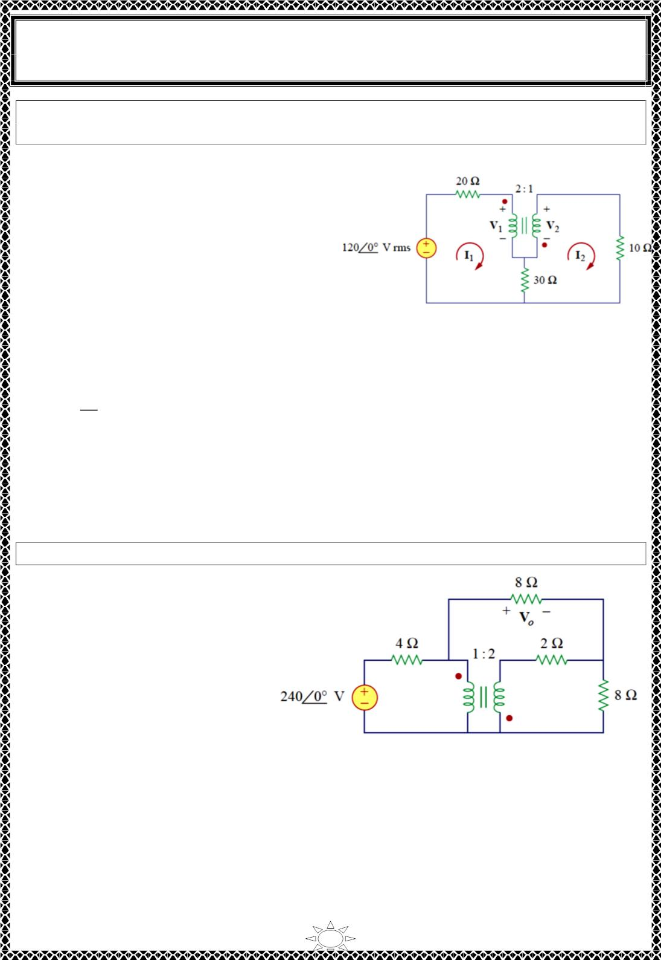
University of Diyala
Engineering College
Electronic Department
Electrical Circuits
2nd Class
Lecturer : Wisam N. AL-Obaidi
Year (2015-2016)
Example 11: Calculate the power supplied to the 10- Ω resistor in the ideal transformer
circuit of Fig. shown
Solution:
Reflection to the secondary or primary side
cannot be done with this circuit: there is
direct connection between the primary and
secondary sides due to the 30- resistor. We
apply mesh analysis.
For mesh 1,
50퐼 − 30퐼 + 푉 = ꢀꢁ0
…(1)
…(2)
1
2
1
For mesh 2,
−30퐼 + 40퐼 − 푉 = 0
1
2
2
At the transformer terminals,
1
푉₂ = −
푉
1
…(3)
…(4)
2
퐼₂ = − ꢁ 퐼₁
Trail Version
Trail Version
Trail Version
Trail Version
Trail Version
Trail Version
Trail Version
Trail Version
Trail Version
Trail Version
Trail Version
Trail Version
Trail Version
Solve Eq.s(1), (2), (3) and (4), we get
퐼₂ = −0.7ꢁ7ꢁ A
The power absorbed by 10- Ω resistor is,
푝 = (−0.7ꢁ7ꢁ)²(ꢀ0) = 5.3 W
H.W.9: Find V_{o} in the circuit of Fig. shown.
Answer:
96 V
21

Slide 7
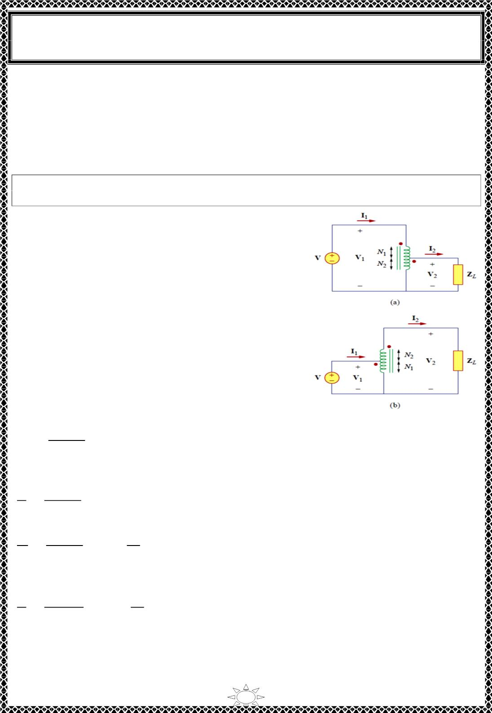
University of Diyala
Engineering College
Electronic Department
Electrical Circuits
2nd Class
Lecturer : Wisam N. AL-Obaidi
Year (2015-2016)
11) Ideal Autotransformers
Unlike the conventional two-winding transformer we have considered so far, an
autotransformer has a single continuous winding with a connection point called a tap
between the primary and secondary sides. The tap is often adjustable so as to provide the
desired turns ratio for stepping up or stepping down the voltage. This way, a variable
voltage is provided to the load connected to the autotransformer.
An autotransformer is a transformer in which both the primary and the secondary
are in a single winding.
Fig.11.1, the autotransformer can operate in the step-
down or stepup mode. The autotransformer is a type of
power transformer. Its major advantage over the two-
winding transformer is its ability to transfer larger
apparent power. Example 12 will demonstrate this.
Another advantage is that an autotransformer is smaller
and lighter than an equivalent two-winding
transformer. However, since both the primary and
secondary windings are one winding, electrical isolation
(no direct electrical connection) is lost. The lack of
electrical isolation between the primary and secondary
Trail Version
Trail Version
Trail Version
Trail Version
Trail Version
Trail Version
Trail Version
Trail Version
Trail Version
Trail Version
Trail Version
Trail Version
Trail Version
windings is
a
major disadvantage of the
autotransformer.
For the step-down autotransformer circuit of Fig.11.1(a),
Fig.11.1
푉₂
푁₁+ 푁₂
푁₁
푁₂
푉
=
푁
2
= 1 +
…(11.1)
1
푆 = 푉 퐼∗ = 푉 퐼∗ = 푆
…(11.2)
…(11.3)
ꢀ
ꢀ ꢀ
ꢁ ꢁ
ꢁ
푉 퐼 = 푉 퐼
ꢀ ꢀ
^{ꢂ}ꢃ
ꢁ ꢁ
ꢅ_{ꢄ}
ꢅ_{ꢃ}ꢆ ꢅ_{ꢄ}
^{ꢂ}ꢄ
=
…(11.4)
For the step-up autotransformer circuit of Fig.11.1(a),
ꢇ
ꢅ_{ꢃ}ꢆ ꢅ_{ꢄ}
ꢅ_{ꢄ}
ꢅ_{ꢃ}
ꢄ
=
= 1 +
ꢇ
ꢅ
ꢃ
ꢃ
푆 = 푉 퐼∗ = 푉 퐼∗ = 푆
…(11.5)
…(11.6)
ꢀ
ꢀ ꢀ
ꢁ ꢁ
ꢁ
푉 퐼 = 푉 퐼
ꢀ ꢀ
^{ꢂ}ꢃ
ꢁ ꢁ
=
ꢅ_{ꢃ}ꢆ ꢅ_{ꢄ}
= 1 +
ꢅ_{ꢄ}
ꢅ_{ꢃ}
…(11.7)
^{ꢂ}ꢄ
ꢅ_{ꢃ}
A major difference between conventional transformers and autotransformers is that the
primary and secondary sides of the autotransformer are not only coupled magnetically but
also coupled conductively. The autotransformer can be used in place of a conventional
transformer when electrical isolation is not required.
22

Slide 8
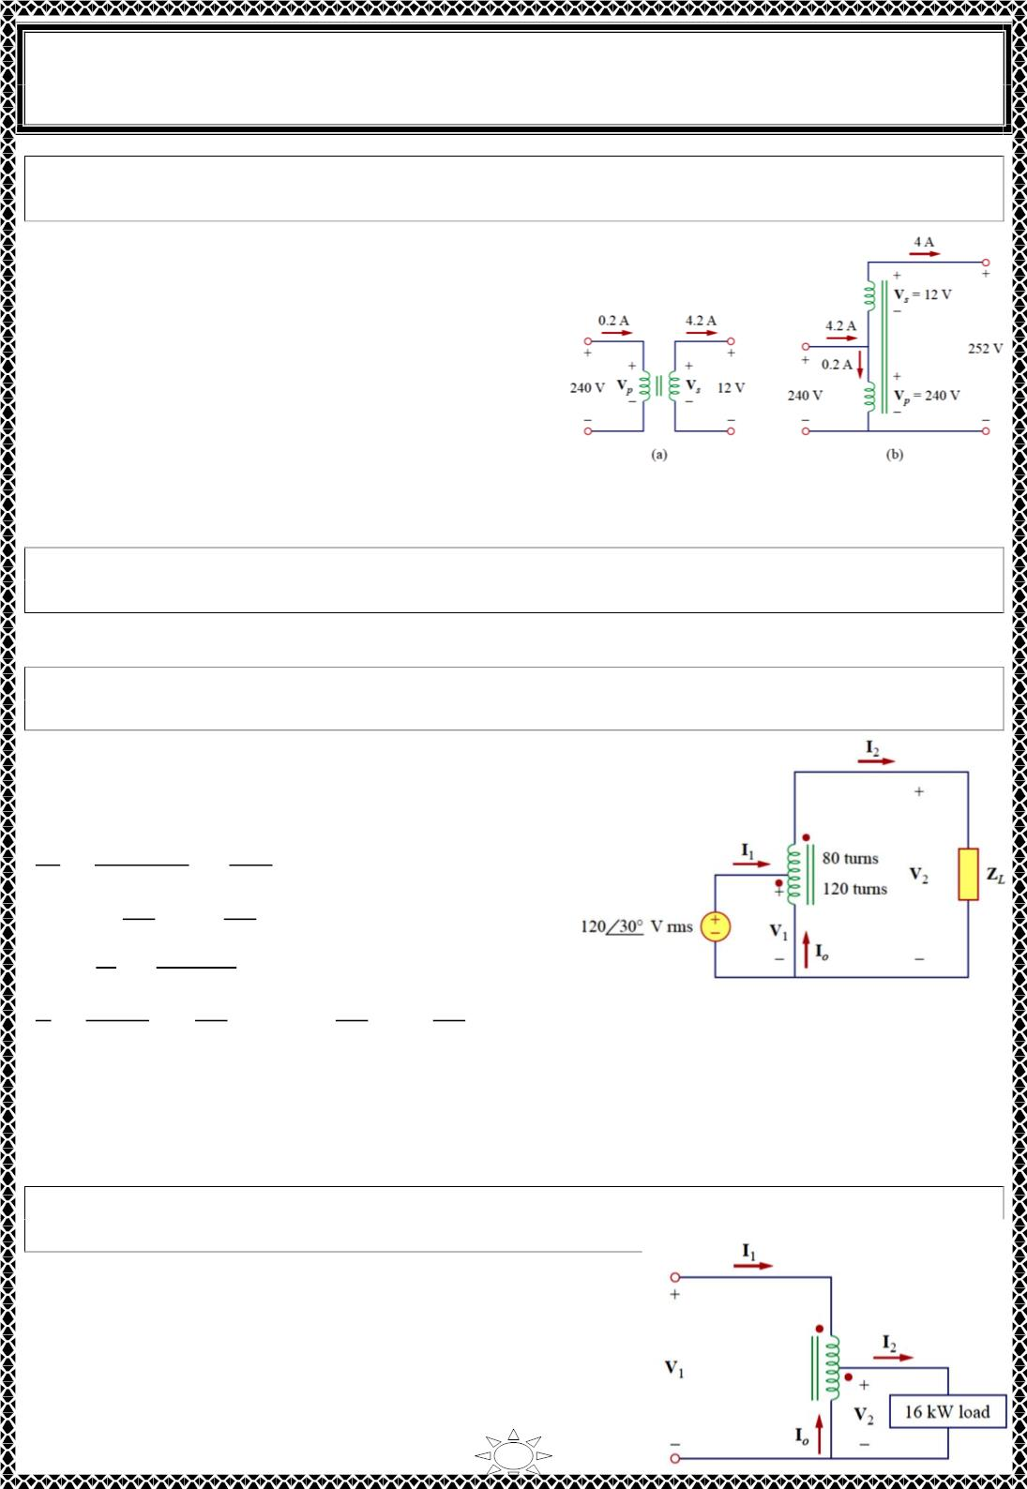
University of Diyala
Engineering College
Electronic Department
Electrical Circuits
2nd Class
Lecturer : Wisam N. AL-Obaidi
Year (2015-2016)
Example 12: Compare the power ratings of the two-winding transformer in Fig. (a) and
the autotransformer in Fig. (b).
Solution:
For the two winding transformer, the power
rating is,
푆 = 0.2×240 = 48 VA
1
or
푆 = 4×ꢁ2 = 48 VA
ꢀ
For the autotransformer, the power rating is,
푆 = 4.2×240 = ꢁ008 VA
1
or
푆 = 4×252 = ꢁ008 VA
ꢀ
which is 21 times the power rating of the two-
winding transformer.
H.W.10: Refer to Example 12. If the two-winding transformer is a 30-VA, 120/10V
transformer, what is the power rating of the autotransformer?
Answer: 390 VA
Trail Version
Trail Version
Trail Version
Trail Version
Trail Version
Trail Version
Trail Version
Trail Version
Trail Version
Trail Version
Trail Version
Trail Version
Trail Version
Example 13: For the autotransformer circuit in Fig. shown. Calculate: (a)I , I and Io if
Z_{L}=8+j6 Ω, and (b) the complex power supplied to the load.
Solution:
(a) This is a step-up autotransformer with,
1
2
푁 = 80, 푁 = ꢁ20, 푉 = ꢁ20∠30^{ꢂ}
1
ꢀ
1
푉
푁 + 푁
200
ꢀ
1
ꢀ
푉
=
푁
=
1
1
80
ꢀꢂꢂ
∴ 푉ꢀ =
ꢀꢂꢂ
ꢃꢂ
푉₁ =
ꢆꢂꢂ∠ꢆꢂ^{ꢇ}
(ꢁ20∠30^{ꢂ}) = 300∠30^{ꢂ} V
ꢄ
ꢃꢂ
ꢅ
= 30∠ − ꢉ.87^{ꢂ} A
퐼ꢀ =
=
^{ꢊ}ꢋ
ꢊ
ꢅ
푍_{퐿}
ꢃꢈ푗6
^{ꢌ}ꢋ^{ꢈ ꢌ}
ꢀꢂꢂ
=
ꢀꢂꢂ
ꢃꢂ
ꢀꢂꢂ
ꢃꢂ
(30∠ − ꢉ.87^{ꢂ} ) = 75∠ − ꢉ.87^{ꢂ} A
=
ꢌ
ꢋ
ꢅ
ꢃꢂ
→ 퐼₁ =
퐼ꢀ =
At the tap KCL gives
퐼 + 퐼 = 퐼 → 퐼 = 퐼 − 퐼 = 30∠ − ꢉ.87^{ꢂ} − 75∠ − ꢉ.87^{ꢂ} = 45∠ꢁ73.ꢁ3^{ꢂ} A
1
표
ꢀ
표
ꢀ
1
(b) The complex power supplied to the load is
푆 = 푉 퐼∗ = |퐼 |ꢀꢍ = (30)ꢀ (ꢁ0∠3ꢉ.87^{ꢂ}) = 9∠3ꢉ.87^{ꢂ} kVA
ꢀ
ꢀ ꢀ
ꢀ
ꢎ
H.W.11: In the autotransformer circuit of Fig. shown. Find currents I , I and Io . Take
V = 1250 V, V = 500 V.
1
2
1
2
Answer: 12.8 A, 32 A, 19.2 A
23

Slide 9

University of Diyala
Engineering College
Electronic Department
Electrical Circuits
2nd Class
Lecturer : Wisam N. AL-Obaidi
Year (2015-2016)
12) Three-Phase Transformers
To meet the demand for three-phase power transmission, transformer connections
compatible with three-phase operations are needed. We can achieve the transformer
connections in two ways: by connecting three single-phase transformers, thereby forming
a so-called transformer bank, or by using a special three-phase transformer. For the same
kVA rating, a three-phase transformer is always smaller and cheaper than three single-
phase transformers. When single-phase transformers are used, one must ensure that they
have the same turns ratio n to achieve a balanced three-phase system. There are four
standard ways of connecting three single-phase transformers or a three-phase transformer
for three-phase operations: Y-Y, ∆-∆, Y-∆, and ∆-Y.
For any of the four connections, the total apparent power S , real power P , and reactive
power Q_{T} are obtained as
T
T
푆_{푇} = √3 푉 퐼
…(12.1)
…(12.2)
…(12.3)
퐿 퐿
푃 = 푆 cos 휃 = √3 푉 퐼 cos 휃
푇
푇
퐿 퐿
푄 = 푆 sin 휃 = √3 푉 퐼 sin 휃
푇
푇
퐿 퐿
Trail Version
Trail Version
Trail Version
Trail Version
Trail Version
Trail Version
Trail Version
Trail Version
Trail Version
Trail Version
Trail Version
Trail Version
Trail Version
Where, V = line voltage , I = line current
L
L
(V = line voltage for the primary side, V = line voltage for the secondary side)
Lp
Ls
(I = line current for the primary side, I = line current for the secondary side)
Lp
Ls
For Y-Y & ∆-∆ transformer in Fig.12.1(a)(b),
푉_{퐿푠} = 푛푉
…(12.4a)
…(12.4b)
ꢀꢁꢂ
퐿푝
퐼 =
퐿푠
ꢃ
For Y-∆, transformer in Fig.12.1(c),
ꢃꢄ
푉 = ꢁꢂ
퐿푠
…(12.5a)
…(12.5b)
√ꢅ
^{√ꢅ ꢀ}ꢁꢂ
퐼 =
퐿푠
ꢃ
For ∆- Y, transformer in Fig.12.1(d),
푉_{퐿푠} = 푛√3 푉
…(12.6a)
…(12.6b)
ꢀꢁꢂ
퐿푝
퐼 =
퐿푠
ꢃ√ꢅ
24

Slide 10
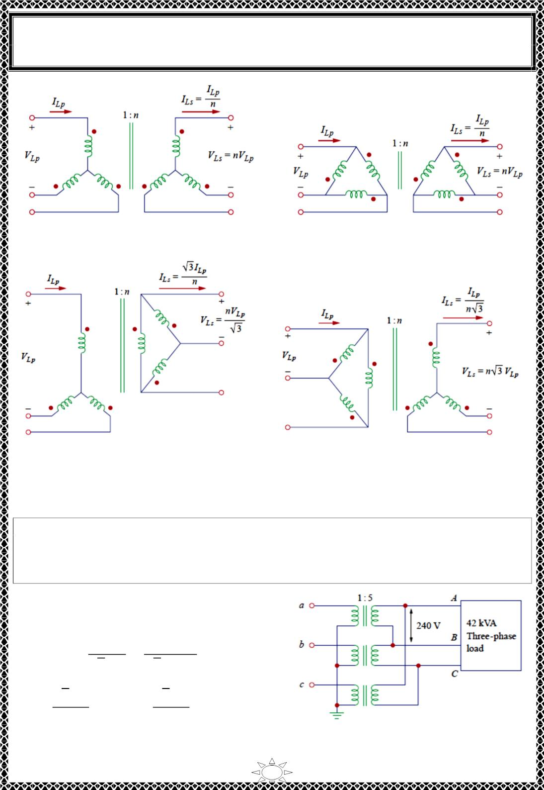
University of Diyala
Engineering College
Electronic Department
Electrical Circuits
2nd Class
Lecturer : Wisam N. AL-Obaidi
Year (2015-2016)
(a) Y-Y three-phase transformer connection
(b) ∆-∆ three-phase transformer connection
Trail Version
Trail Version
Trail Version
Trail Version
Trail Version
Trail Version
Trail Version
Trail Version
Trail Version
Trail Version
Trail Version
Trail Version
Trail Version
(c) Y-∆ three-phase transformer connection (d) ∆-Y three-phase transformer connection
Fig.12.1
Example 14: The 42-kVA balanced load depicted in Fig. is supplied by a threephase
transformer. (a) Determine the type of transformer connections. (b) Find the line voltage
and current on the primary side. (c) Determine the kVA rating of each transformer used in
the transformer bank. Assume that the transformers are ideal.
Solution:
(a) The transformer is Y-∆ connected
(b)
퐼 =
퐿푠
푆_{푇}
=
42000
= 101 퐴
√3 푉
√3 ×240
퐿푠
퐼 =
퐿푠
√3 퐼_{퐿푝}
푛
→ 101 =
√3 퐼_{퐿푝}
5
∴ 퐼_{퐿푝} = 292퐴
25

